Slide 1
Applied Research in TVET
A Case of Hong Kong
Professor Simpson Poon
Vice President

Slide 2
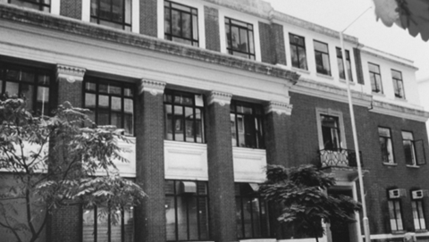
1937
1st Government post-secondary technical institution set up

Slide 3

TVET in Hong Kong
The Vocational Training Council (VTC)
  Established in 1982
  Currently educated/trained around
  250,000 students per year
  Covering Disciplines:
Applied Sciences Business Administration Child Care and Gerontology Design | Engineering Hotel Serv. & Tourism IT

Slide 4
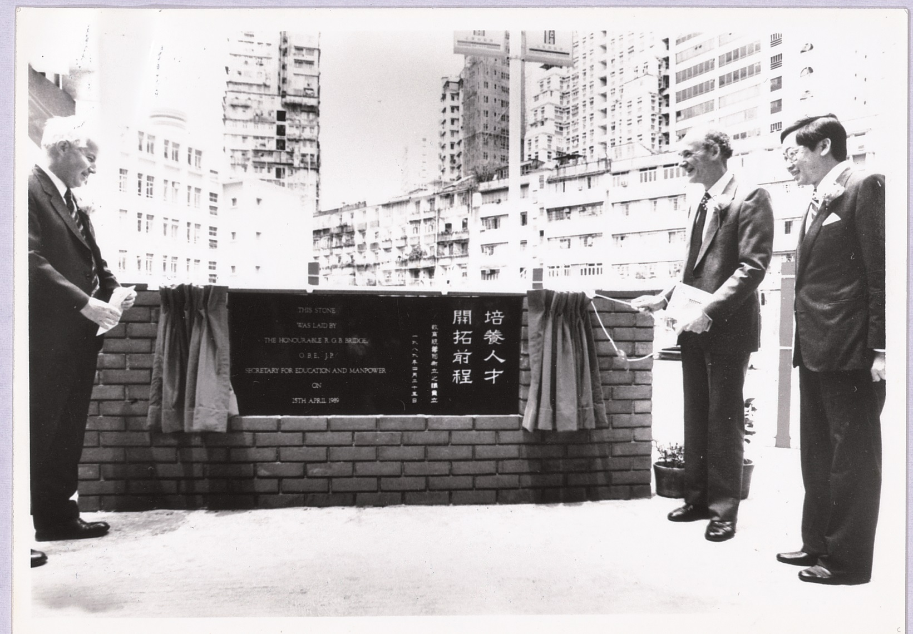

Slide 5

VTC today
Hong Kong’s largest TVET Group – a public (or quasi-government) organisation
Academies
Institutes

Slide 6
Applied Research – why needed?
  Differentiate between Bachelor degree-level (HKQF Level 5) and Sub-degree level programmes (HKQF Level 4)
  From “good at using your hands” to also “good at using your brain”
  Transforming from a skills-based society to a “skills- AND knowledge-based” society

Slide 7
7-level Hierarchy under HK Qualifications Framework (HKQF)
Academic Sector
QF Levels
Level 7
Level 6
Level 5
Level 4
Level 3
Level 2
Level 1
Vocational/Continuing
Education Sectors
Doctoral Degree
To be more
systematically
developed, quality
assured and ordered
under QF
e.g.
- Recog. Of Prior Learning
- Articulation Pathways
- Spec. Comp. Standard-
based courses
Master Degree
Bachelor Degree
Assoc Deg/Higher Dip
DSE/Diploma/Sec. 7
Sec. 5/Certificate
Sec. 3/Certificate
Source: QFS

Slide 8
Desirable graduates’ attributes
  Equipped with latest professional knowledge
  Easily integrated into a team
  Professional ethics
  Inter-personal skills
  Etc…

Slide 9
3 ways to promote Applied Research
  Seed grants
  Performance-based evaluation
  Evaluation criteria for promotion

Slide 10

Seed Grants
  Allow new faculties who come from industry to engage in Applied Research
  Awarding criteria: potential to attract industry grants; relevant to curriculum/institute’s development; quantifiable demand from industry on the outcome, etc.
  Future grants depend on
  past records

Slide 11

Performance-based evaluation
  80% on teaching; 20% on research as a “principle”, but customisable
  Objective-driven criteria – How can we achieve the desirable graduates’ attributes based on our staff’s performance?
  A contract-based system with graduity

Slide 12
Evaluation criteria for promotion
  Industry-based research is equally respected and “counted”
  Consultancy incomes are as worthy as government research grants
  Quantitative indicators such as improving business performance are as useful as citation indexes

Slide 13
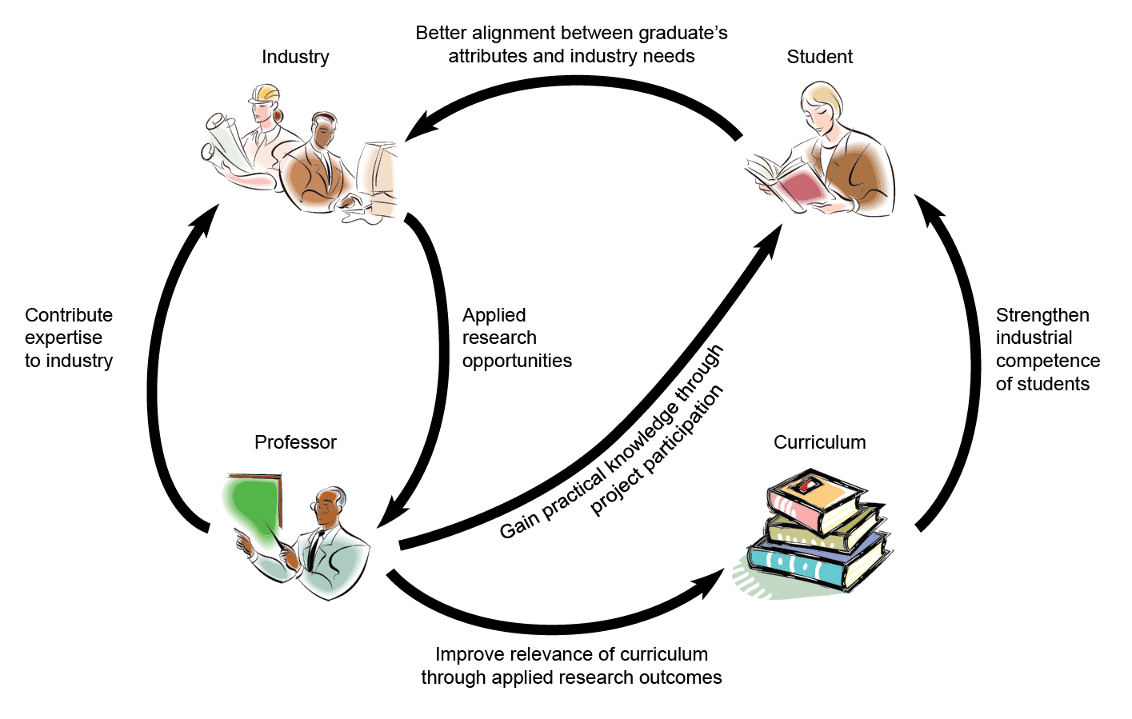
THEi Applied Research Model (TARM)

Slide 14
Since 2012, TARM has helped us to bring in:
Industry/Applied Research grants:
  850,000 Euros
Setting up an Environmental Research Centre:
  600,000 Euros
Donations:
  200,000 Euros
Consultancies
  213,000 Euros

Slide 15
“The road to success is always under construction”
                Arnold Palmer

Slide 16
Thank You
Questions and Discussion

