Slide 1
Futuro del Empleo, Transformación Digital y Competitividad Sostenible
V Congreso Empleo 2022, Donostia – San Sebastián,
27 Octubre 2022
Mikel Landabaso , Director – Growth and Innovation
Joint Research Centre, European Commission

Slide 2
Índice
Crisis que afectan al futuro del empleo
Oportunidades de la transición verde para el empleo
Riesgos para el empleo en la transición digital:
  Automatización: Robots e inteligencia artificial
  Gestión algorítmica y el trabajo en las plataformas digitales (Gig Economy)
  Teleworking y espacios de trabajo en la era post-Covid
Políticas públicas de apoyo a la transición y el empleo de calidad

Slide 3



Un factor de producción como ningún otro…
“People need to have meaning in their life. They need to make a difference in their job. People are looking for respect in the job that they are doing, and in the community they’re living in, and that’s much, much more dominant than the financial incentive.” (Esther Duflo)
“Individuals gain not only income, but meaning, status, skills, networks and friendships through work” (Ian Goldin)
“El empleo sigue siendo el mecanismo fundamental por el que la población participa de los frutos de la producción y los ciudadanos pueden ejercer su propia libertad individual en una economía de mercado” (Roberto Velasco) ​

Slide 4

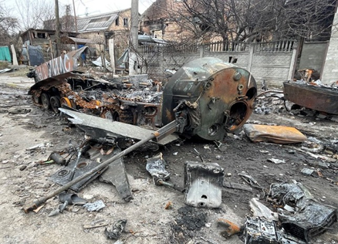

Crises as opportunities for deep transformation
“When people find themselves in a new situation, they adapt and change. But as long as they expect things to stay as they are … they do not easily listen to new ideas”.
Jean Monnet
Climate crisis
War in Ukraine
COVID-19 pandemic
Green Deal as EU’s
long-term economic development strategy
Accelerate the transition to renewable energy
Consensus for economic recovery package

Slide 5
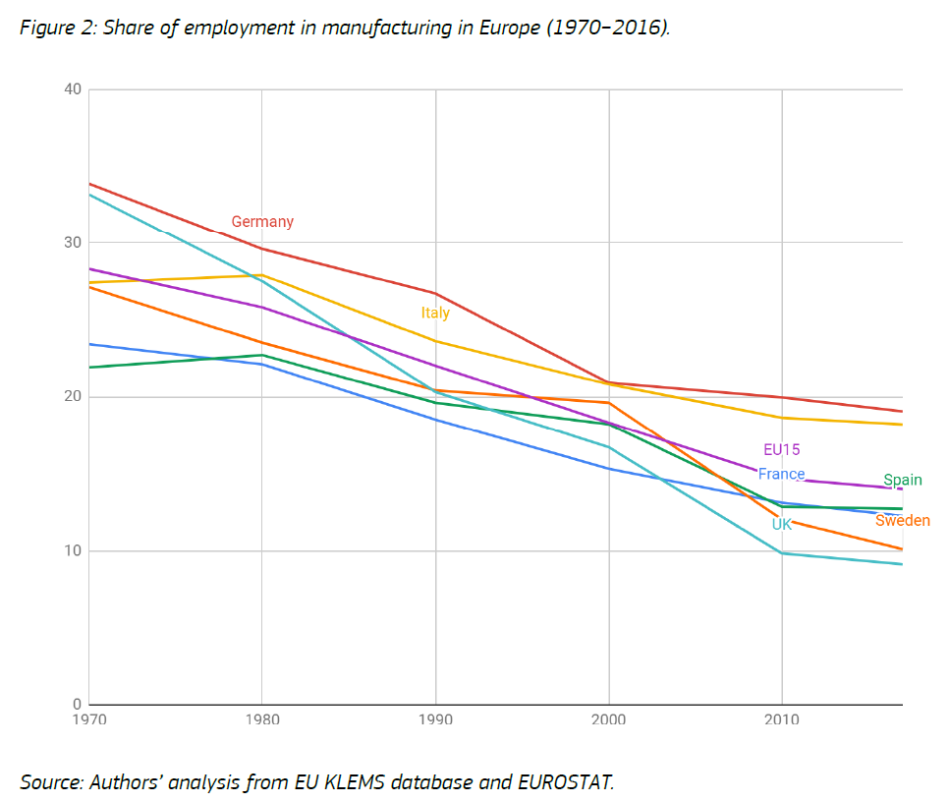

Employment share of manufacturing in Europe (Klenert et al., 2020)
The Multiplier Effect
"We are seeing growing evidence that manufacturing supports far more jobs in other sectors than previously thought."
"As manufactured products and processes become more complex and productive, they give rise to a host of skilled paraprofessional and professionals in nonmanufacturing jobs"
(Jasinowski, 2013)

Slide 6
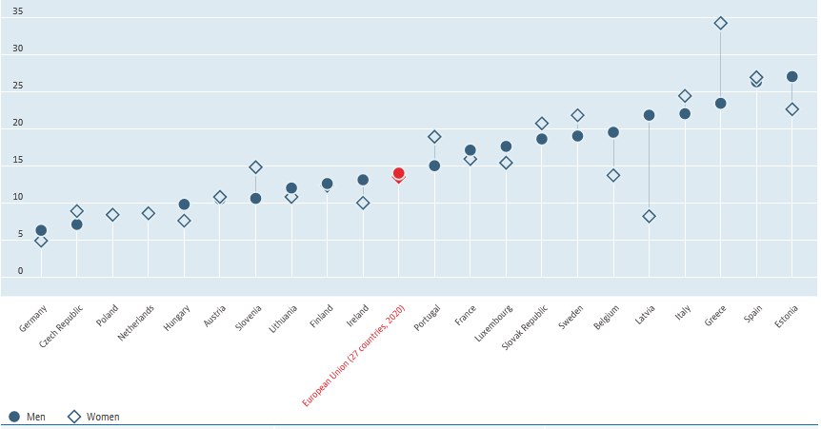
Youth unemployment rate in Europe Aug 2022
OECD, 2022

Slide 7
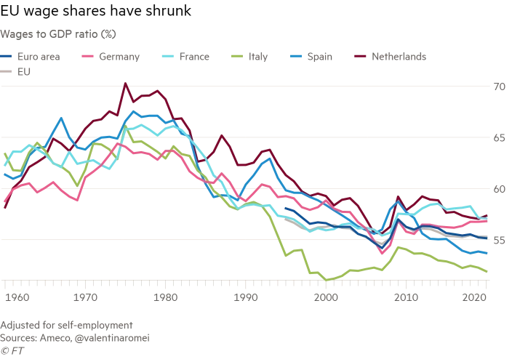
Salaries in GDP

Slide 8

Change among occupational groups, 2002-2020
Percentage point change among shares of occupational groups, 2002-2020
Source: Science, Research and Innovation Performance of the EU 2022 [UPCOMING]
(DG R&I based on Eurostat data)

Slide 9
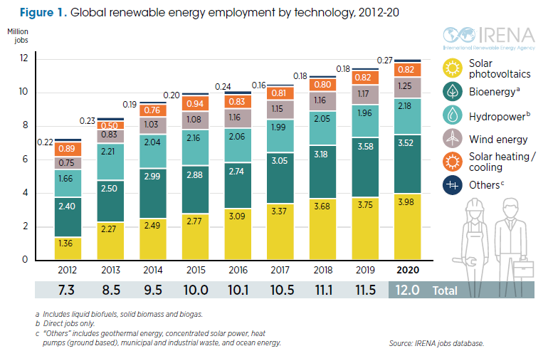

Green opportunities
700 000 new jobs in global renewable energy sector in 2021 (12.7 million (2021) vs. 12 million (2020))
Wind turbine service technician is one of the fastest-growing jobs in the US. (U.S. Bureau of Labor Statistics, 2022)
EU: Expected net increase of up to 884 000 jobs by 2030 (Asikainen et al., 2021)
Substantial implications for different economic sectors and regions
Shift of jobs from coal, oil, and gas to other sectors, in particular to renewable energy sectors

Slide 10
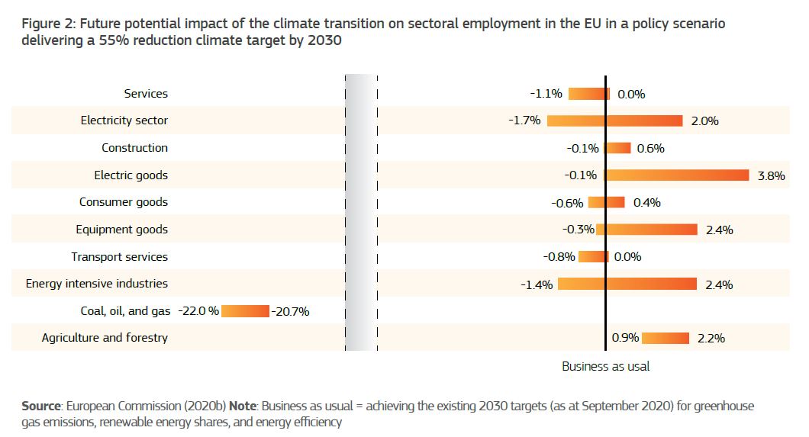

Impact of climate transition on employment by sector
2021

Slide 11
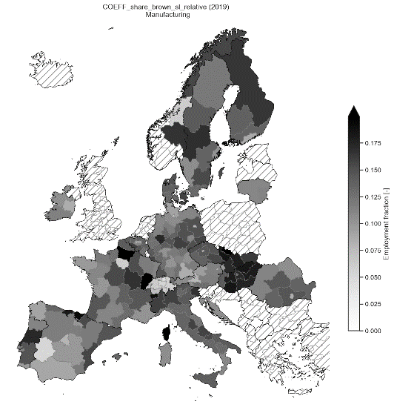
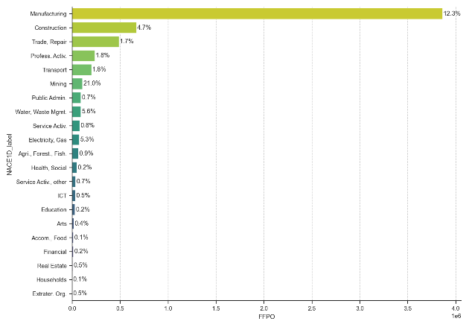
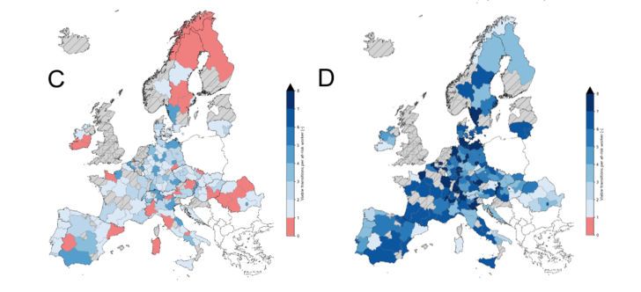
Transitioning out of "brown" jobs through the right reskilling
A
B
Brown jobs are distributed unevenly across sectors.
Brown jobs are distributed unevenly across regions (shows manufacturing only)
Workers in coal jobs (subset of “brown” jobs at threat) have limited transition options (# of viable transitions low).
Reskilling that is informed by skills proximities increases transition options dramatically.
Policymakers need to understand local reskilling potential

Slide 12
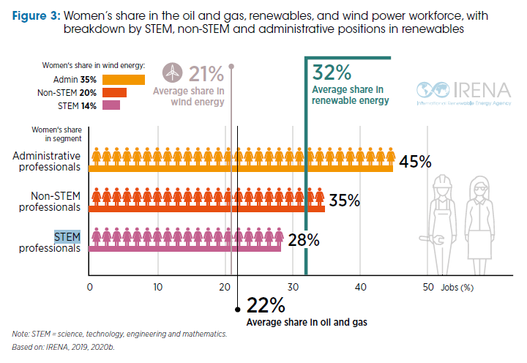
Need for a gender-balanced transition

Slide 13
Digital transition
The digital transformation is a widespread acceleration of the pace of technological change in the economy, driven by a massive expansion of the capacity to store, process and communicate information using electronic devices.
It leads to a new division of labour in the economy.
With respect to work, three main drivers of change:
… requiring different policy responses
  Automation of employment: replacement of tasks by machines.
Upskilling/ Reskilling/ Complementary skills
2. Digitalization of processes: moving more and more stages of the production process to the digital sphere.
Data rights, digital skills & labour rights
  3. Algorithmic management of work (Platformisation)​
Algorithmic transparency & Social dialogue

Slide 14
Automatización y Empleo
“At all levels of analysis — plant, firm, and industry — the estimated impact of automation on employment in France is positive, even for unskilled industrial workers.”
Phillipe Aghion, 2022, at the first conference on the economic impact of robots and automation that took place on October 13/14, 2022, at Goethe University Frankfurt am Main, Germany
Organisation | Estimates | Comments
ILO | 56% of jobs at risk of automation in next 20 years | ILO, 2016 (for ASEAN-5)
World Bank | 66% of jobs at risk of automation | WB, 2016 (by WB and IMF)
OECD | 14.5% of jobs in 34 OECD countries at high-risk and 32% at significant risk | OECD, 2019
Deloitte | 35% of jobs might disappear in the next two decades | Deloitte, 2014
PwC | 38% of jobs in US, 35% in Germany, 30% in the UK, 21% in Japan, at risk of automation | Pricewaterhouse Cooper 2017; study of the US, Japan, UK and Germany
McKinsey | 60% of all occupations have at least 30% automatable activities | McKinsey Global Institute 2016
Bruegel | 47%-54% of jobs at risk of automation in the EU | Bruegel Blog 2014
World Economic Forum | 75 million jobs lost world-wide and 133 million created | WEF, 2018
Roland Berger | 8.3 million jobs lost in industry; 10 million jobs created in services by 2035 | Study in 2016 for Western Europe
Researchers, University of Oxford | 47% of workers in the US at high risk of automation in 2030; 20% in Spain in 20 years | Frey and Osborne, 2013 (focused on the US)
Researchers, Harvard University, OECD | Jobs at high risk of automation vary between 6% in Norway to 33% in Slovenia | Nedelkoska and Quintini, 2018 (study on OECD countries)
Researchers, LSE Consulting | Jobs at high risk of automation vary between 37% in Norway to 69% in Czechia | Lordan, 2018
Researchers, Centre for European Economic Research | 9 % of jobs at risk of automation in the OECD countries; 9% in the US, 6% in South Korea | Arntz, Gregory and Zierahn, 2016
Researchers, MIT, Boston University | Each robot substitute 6 workers | Acemogly and Restrepo, 2019 (USA 1990-2007)
Researchers, Bruegel | Each robot substitute 3-4 workers | Chiacchio et al, 2018
Oxford Economics | Each robot substitute 1.6 workers | Oxford Economics, 2019
Boston Consulting Group | 4 times more robots in the US will result in job losses of 0.9%-1.76% of the population | Boston Consulting Group, 2015
Keynes | In 2030 “technology unemployment” and “15 hours work per week” in 2030 | 1930

Slide 15
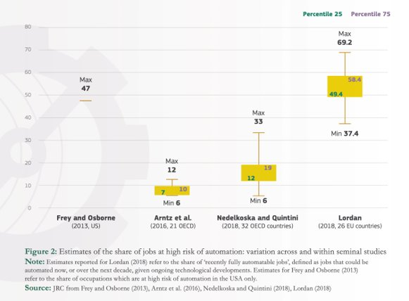
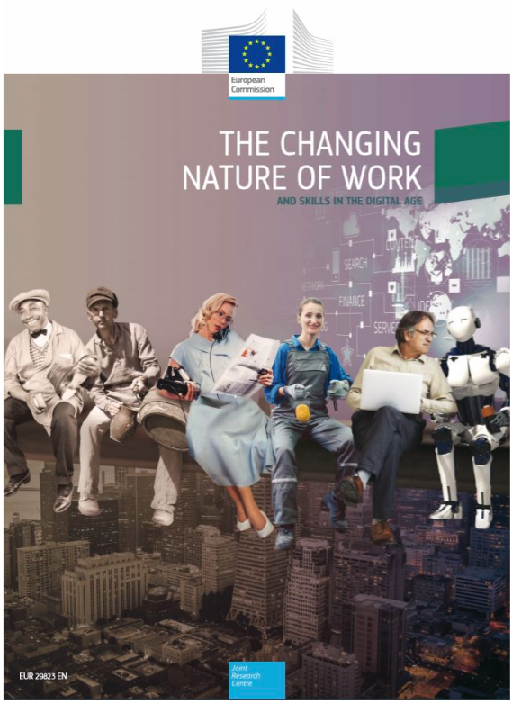

Share of jobs at high risk of automation:
Variation in estimates
2019
OECD, 2021

Slide 16

Future of work in a post-COVID world (McKinsey Global Institute, 2020)
Declining supply of labour due to ageing (- 13.5 million (4%) by 2030)
Urbanization trends: 48 cities could capture more than 50% of Europe’s potential job growth
40% of Europeans will live in regions where jobs are declining

Slide 17
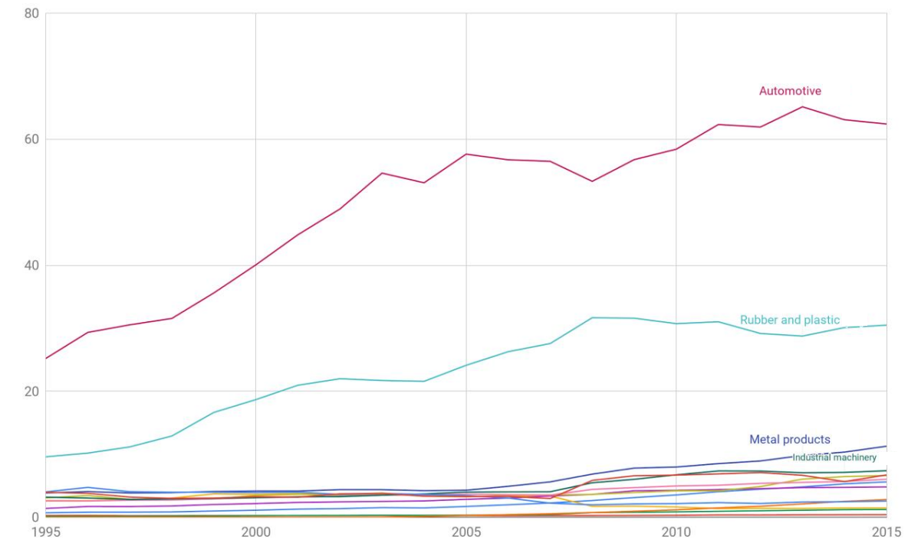
Density of robots per 1,000 workers in the EU, 1995-2015
Source: Fernandez-Macias, Klenert (Anton) (2020), Not so disruptive yet? Characteristics, distribution and determinants of robots in Europe, JRC Working Papers on Labour, Education and Technology 2020-03, Joint Research Centre.

Slide 18
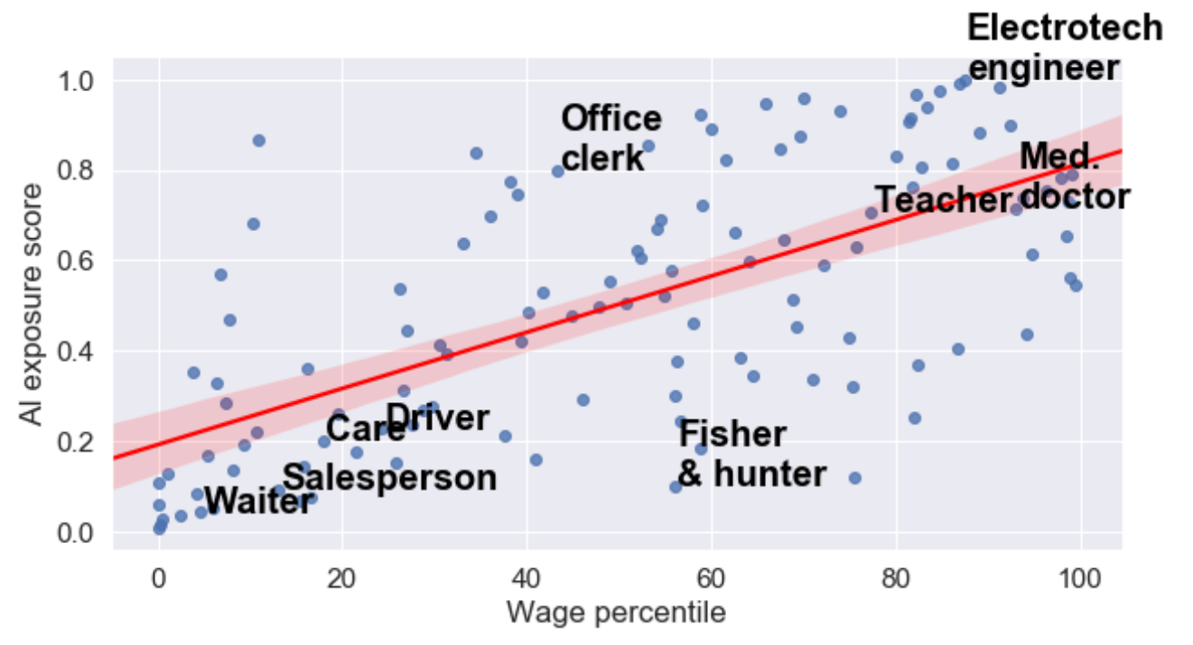
Exposure to AI by wage level, different occupations (EU)
"There's an opportunity […] to implement new ways of working based on technological solutions that could foster flexibility for all workers,…"
"At the same time, automation promises to handle more and more rote, repetitive tasks, allowing non-desk workers to be reskilled to handle jobs calling for the human touch."
(The Adecco Group, 2022)
Source: Tolan, S., Pesole, A., Martínez-Plumed, F., Fernández-Macías, E., Hernández-Orallo, J., Ms Gómez, E. (2021). Measuring the occupational impact of AI: tasks, cognitive capabilities and AI benchmarks. Journal of Artificial Intelligence Research, 71, 191-236.

Slide 19
Algorithmic management of work (platformisation)
Use of digital algorithms and platforms for work management tasks.
  It involves some automation of management (which is never complete).
  It can be used for different management functions: procurement, planning, coordination, control.
  It requires a certain degree of digitalisation of processes. Digitalisation favours platformisation, because algorithms are the most efficient way to manage data.
Algorithmic management of work in Europe
  The most advanced forms of algorithmic management are found in digital labour platforms, which account for around 2 % of employment in Europe. After strong initial growth, they appear stagnant.
  However, algorithmic management of work is spreading across the economy. The increasing use of digital tools in all types of processes favours algorithmic management.
  The COVID crisis, with the need to reduce social interaction (teleworking) and to monitor workers’ location and health status, has boosted the platformisation of work in Europe.

Slide 20
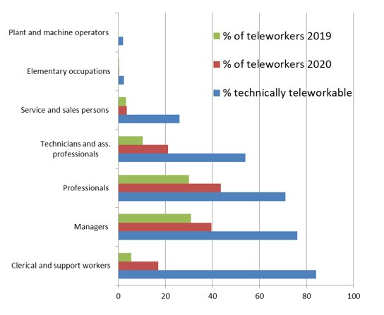
Potential and actual teleworking, before and during COVID (EU)
Source: Sostero, Milasi, Hurley, Fernandez-Macias and Bisello (2020). Teleworkability and the COVID-19 crisis: a new digital divide?, JRC Working Papers on Labour, Education and Technology 2020-05, Joint Research Centre.

Slide 21

Need for a clear and visionary public policy
Anticipating skills needs
Industrial policy based on innovation (closer connection to labour policy)
… legal & institutional improvements (collective bargaining)

Slide 22
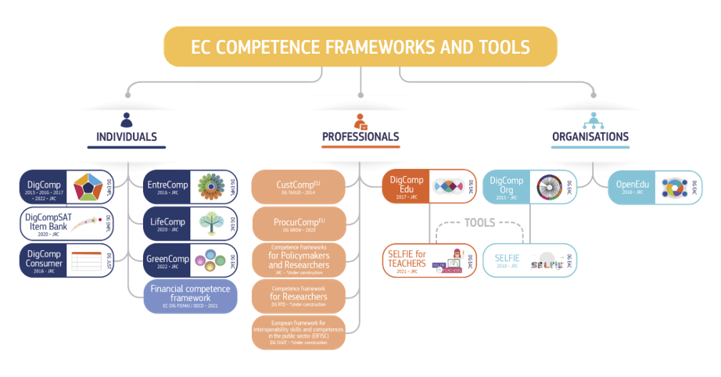
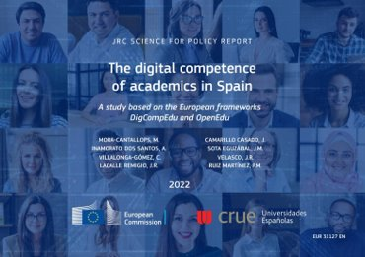
Anticipating skills needs: Matching supply of and demand for skills
The right skilling will enable the transition towards a sustainable energy sector to yield a net growth of 18 million jobs worldwide (ILO, 2019, “Skills for a Greener Future”)

Slide 23
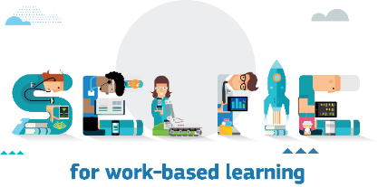
Euskadi case in VET Education
Modelo de Madurez para la transformación digital sostenible de la FP
Monitoring tool
DigCompEdu
DigCompOrg
Learning model
+3,500 users

Slide 24
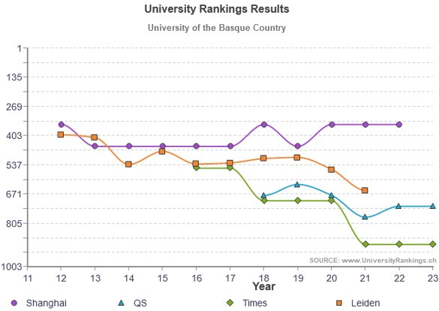
The University of the Basque country – An international comparison
(UniversityRankings.ch, 2022)

Slide 25
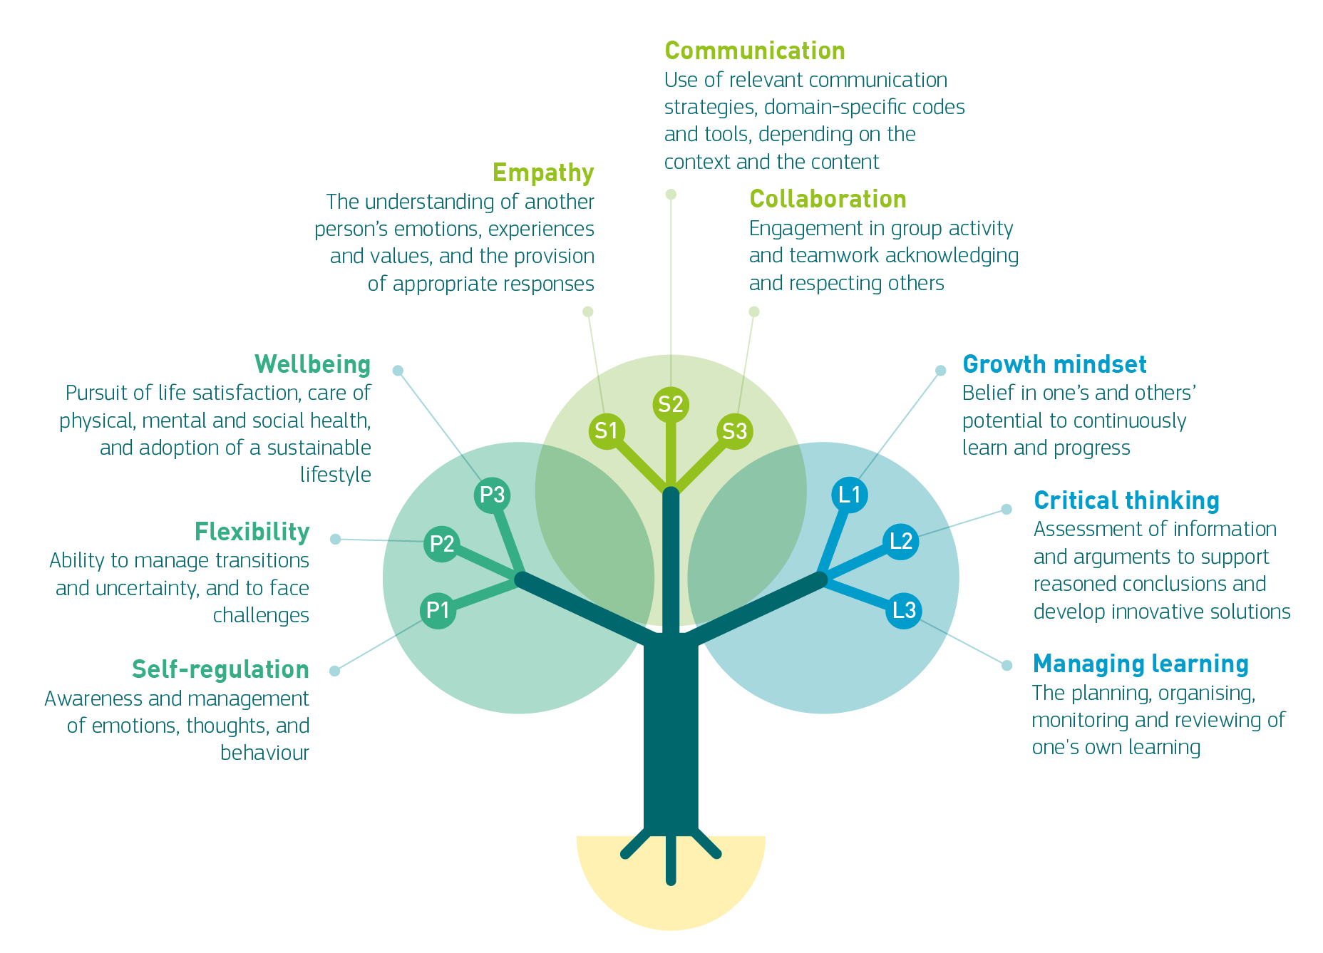

LifeComp: The European Framework for Personal, Social and Learning to Learn Key Competence
Socio-emotional skills; Non-cognitive skills; Soft skills;
Not fixed personality traits but competences learnable life-long and life-wide;
Linked to improved:
  educational outcomes
  life outcomes
LifeComp into Action
Targets teachers and educators;
Selection of research-based principles, guidelines and teaching strategies to foster life skills while teaching the regular curriculum;
Tested and fine-tuned with teachers

Slide 26
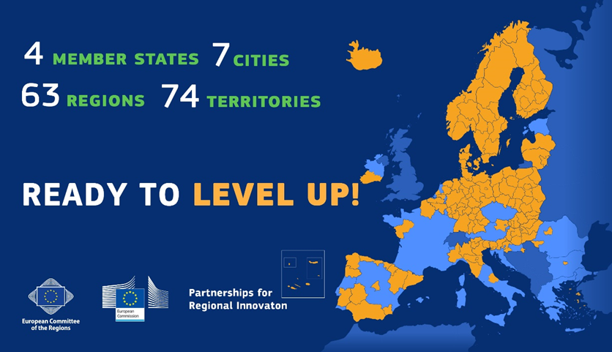
The value of co-creation: Partnerships for Regional Innovation
“It is about shaping a different future: co-creating markets and value, not just 'fixing' markets or redistributing value. It's about taking risks, not only 'de-risking'. And it must not be about levelling the playing field but about tilting it towards the kind of economy we want.” (Mariana Mazzucato)
A new strategic approach to innovation-driven territorial transformation, linking EU priorities with national plans and place-based opportunities and challenges
Partnerships for sustainability transitions that create economic, social & environmental value
Participatory governance framework in support of forward-looking policy
New ways of working across government departments and levels focused on solving territorial challenges

Slide 27
Thank you
© European Union 2022
Unless otherwise noted the reuse of this presentation is authorised under the CC BY 4.0 license. For any use or reproduction of elements that are not owned by the EU, permission may need to be sought directly from the respective right holders.
.

