Slide 1



REFRAMING AGING
@HunterBrookdale
Ruth Finkelstein, ScD
Professor of Public Policy
Executive Director
Brookdale Center for Healthy Aging, Hunter College

Slide 2
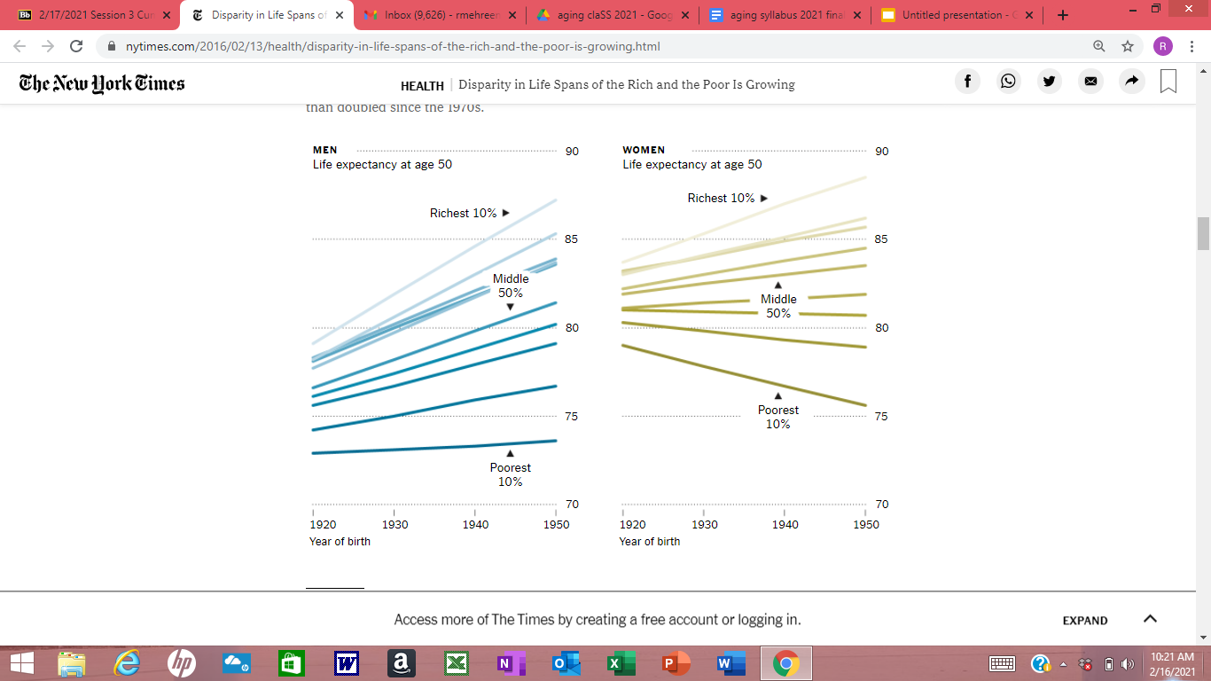

An expanding longevity gap
Source: Gary Burtless; Brookings Institution; U. of Michigan Health and Retirement Study (By The New York Times)

Slide 3
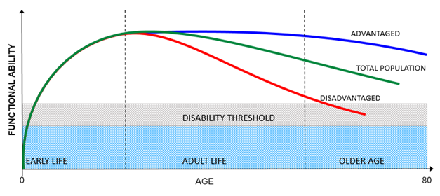
Cumulative Disadvantage

Slide 4
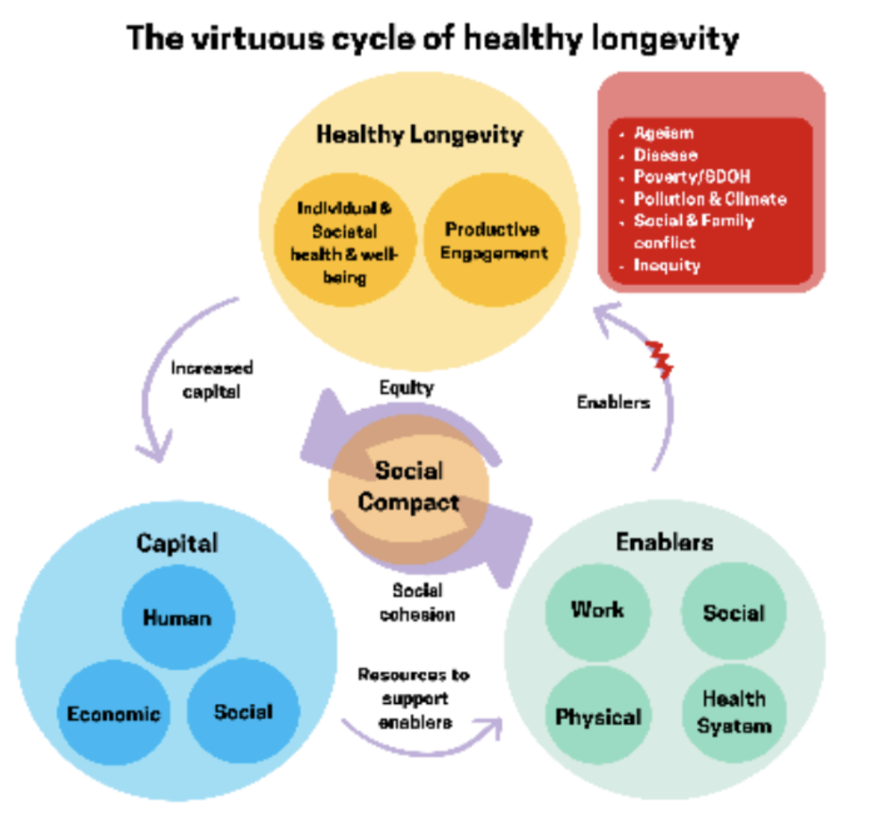
Source: Global Roadmap for Healthy Longevity June 2022 (U.S. National Academy of Medicine)

Slide 5
Older Adults in Basque Country
Currently about 25% of population is 65 and over.
By 2031, more than half the population will be over 50 years.
Currently 1.5 people 65+ for each person under age 16.
Life expectancy at birth is age 83.3.
Life expectancy at 65 is 21.3 years.

Slide 6
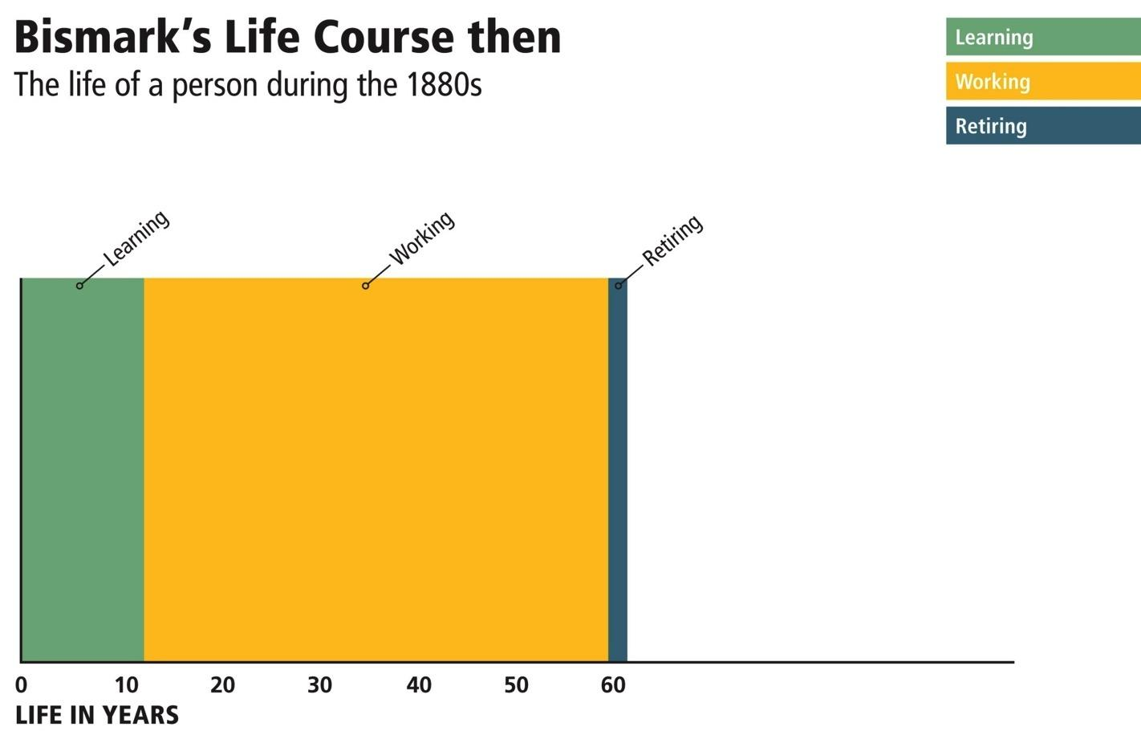
Source: Adapted from Alexander Kalache 2013 The Longevity Revolution: Creating a Society For All Ages

Slide 7
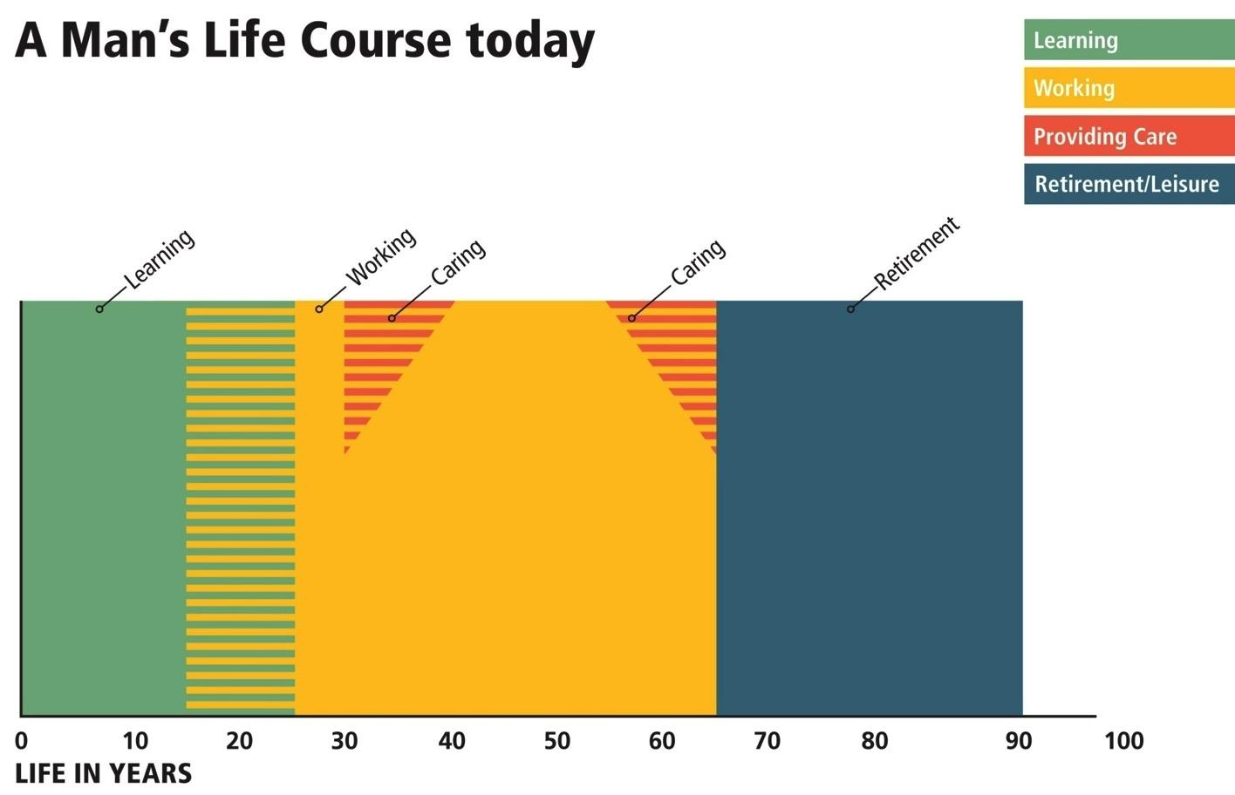
Life Course Today
Source: Adapted from Alexander Kalache 2013 The Longevity Revolution: Creating a Society For All Ages

Slide 8
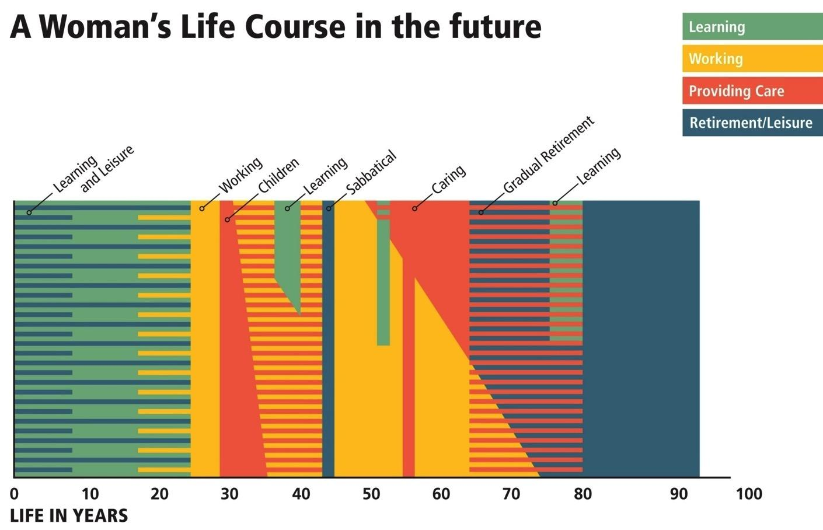
Projected Future Life Course
Source: Adapted from Alexander Kalache 2013 The Longevity Revolution: Creating a Society For All Ages

Slide 9
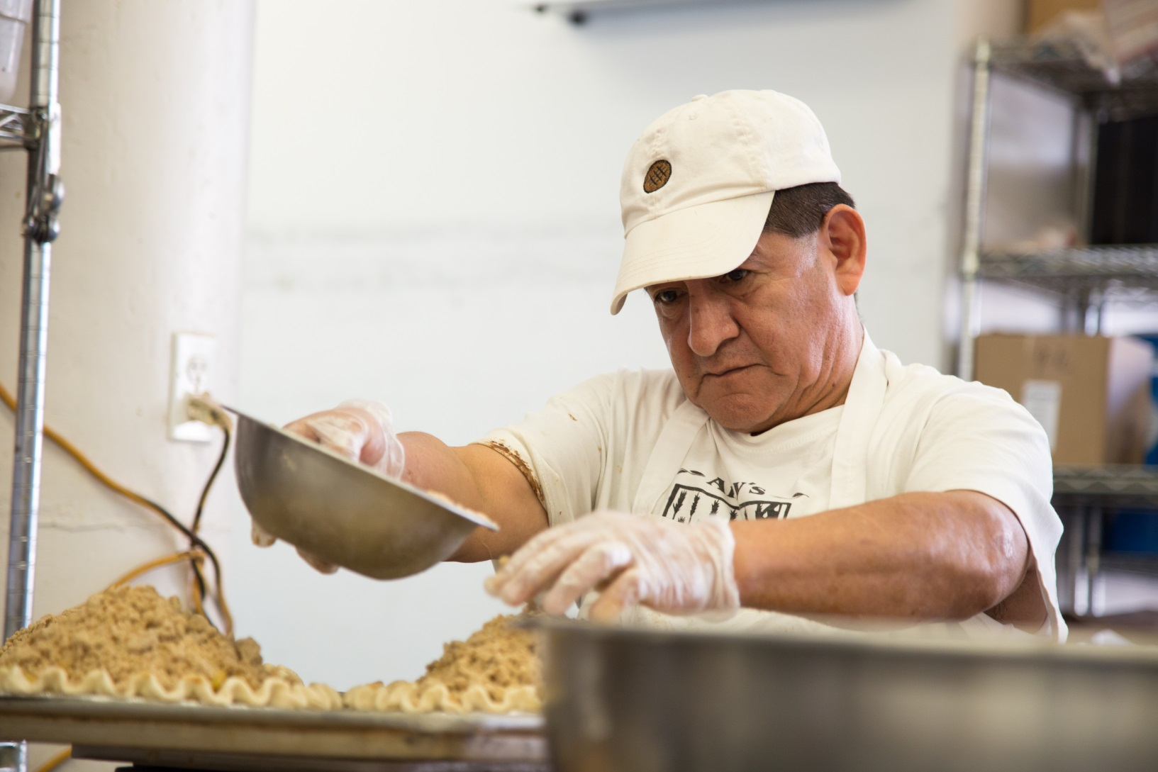
Older Workers
Amy’s Bread, a retail and wholesale bakery, restructures roles so that jobs are not as physically taxing on valuable, older workers.

Slide 10
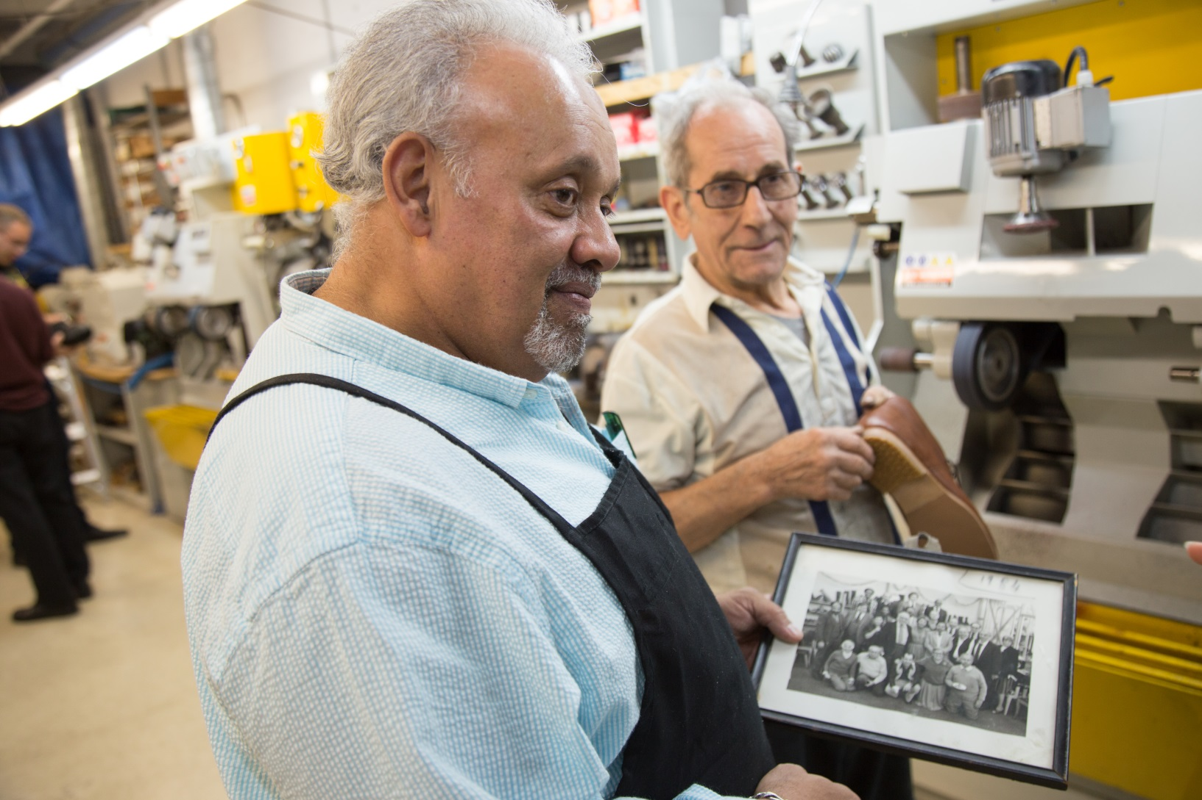
Older Workers
At Enselow Shoes, a comfort shoewear company, workers can “dial up” and “dial down” their hours as they desire.

Slide 11
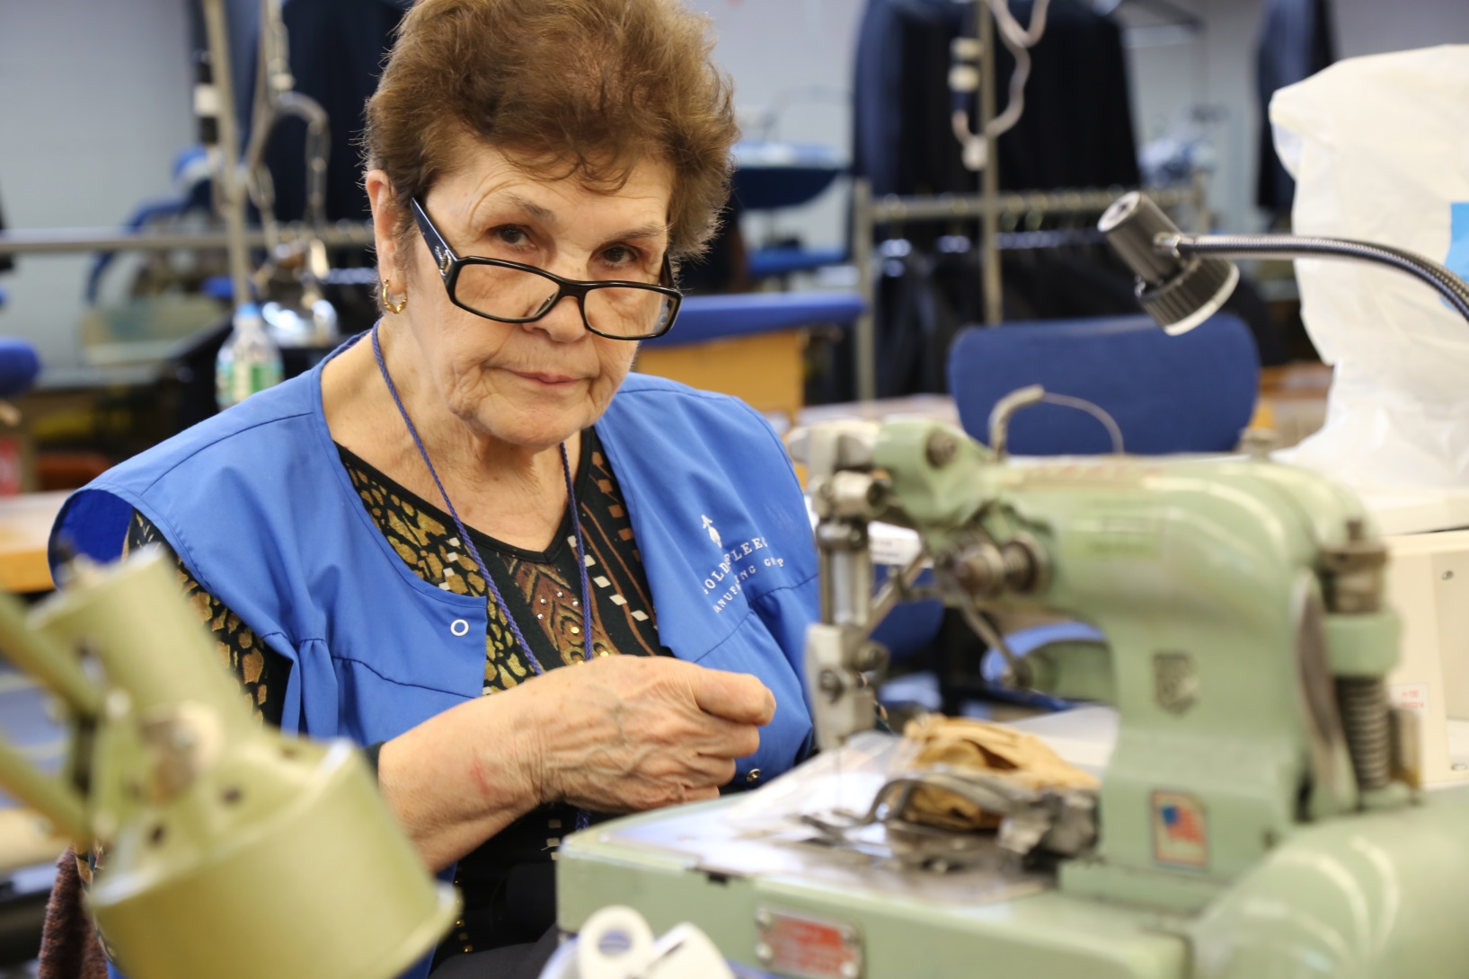
Older Workers
Brooks Brothers factory in Long Island City makes all of the company’s neckties, and 40% of the workers there are over age 50. The factory grapples with a local and national tailor shortage, by valuing existing employees.

Slide 12
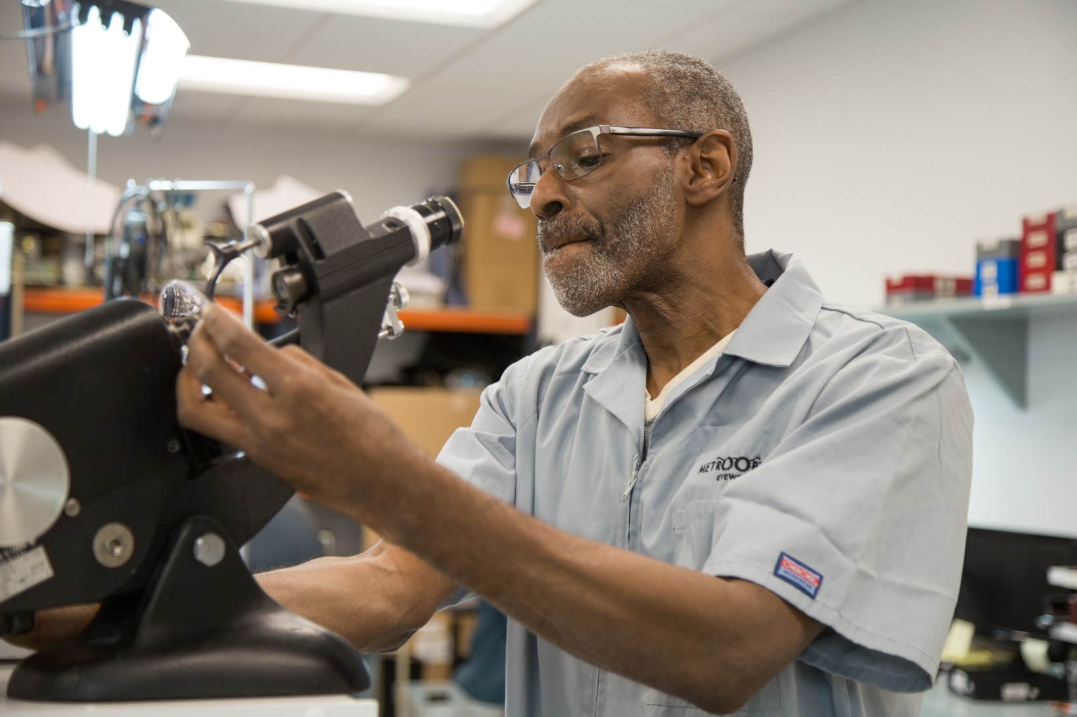
Older Workers
At Metro Optics, a vision care and eyewear company, many of the people hired to work in their lab learned how to make glasses in a job training program in prison. Several recently hired entry-level employees are older patients who were in need of work.

Slide 13
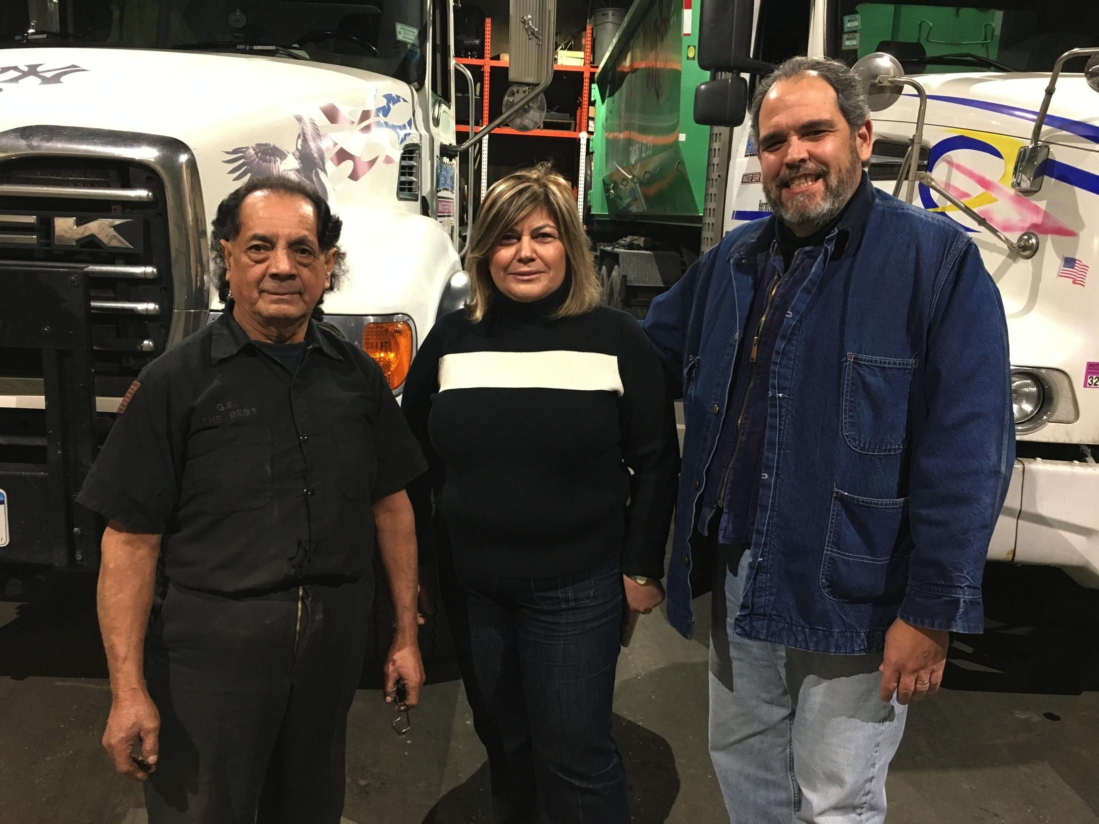
Older Workers
At Hermes Waste Removal, valued, senior garbage truck drivers are given lower-paid assistants to do the heavy lifting, who the drivers, in turn, train.

Slide 14
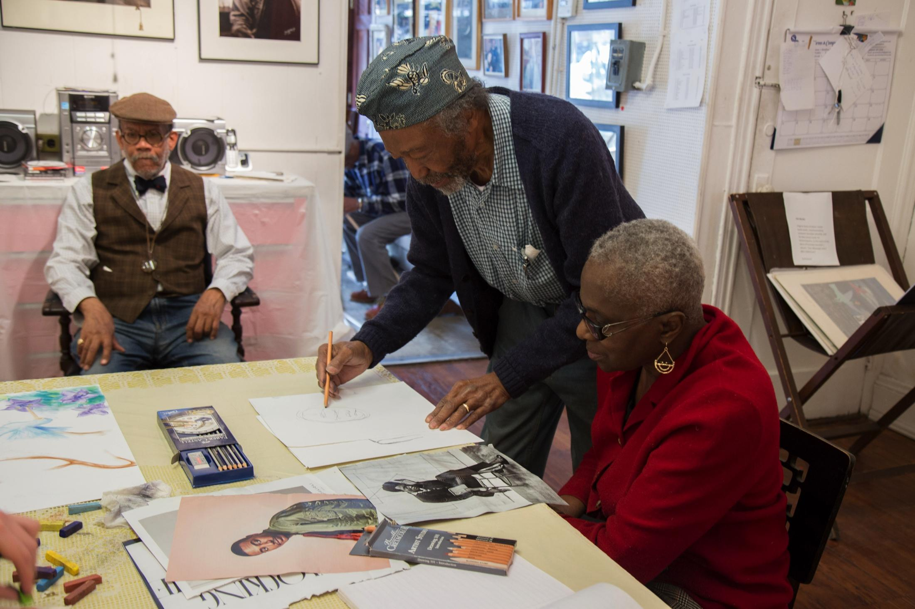
Older Workers
Otto Neals, a retired U.S. Postal worker and artist, teaches weekly art classes open to the community. He was surprised at the number of postal workers who came to sit on the benches outside the post office after retiring. He said they seemed to crave the routine and did not know what else to do.

Slide 15
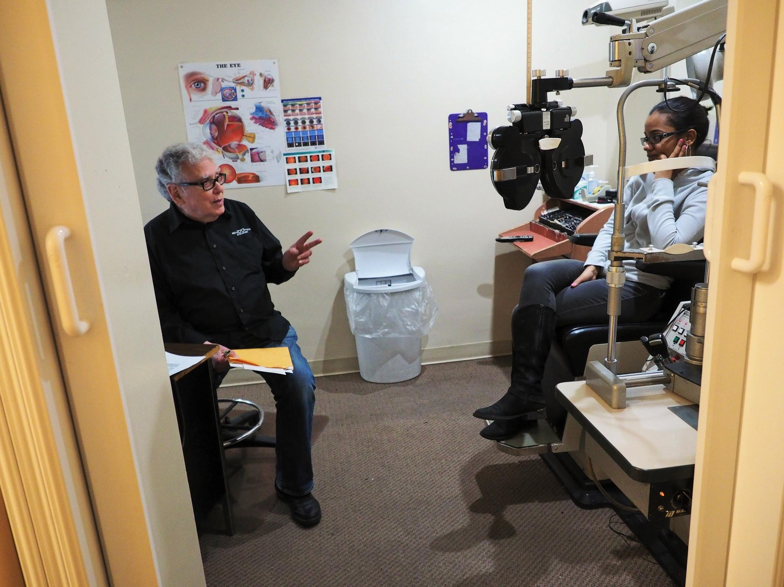
Older Workers
Hank Blum, retired and returned to work as an optometrist four times, because he missed working and the structure and purpose it provided.

Slide 16
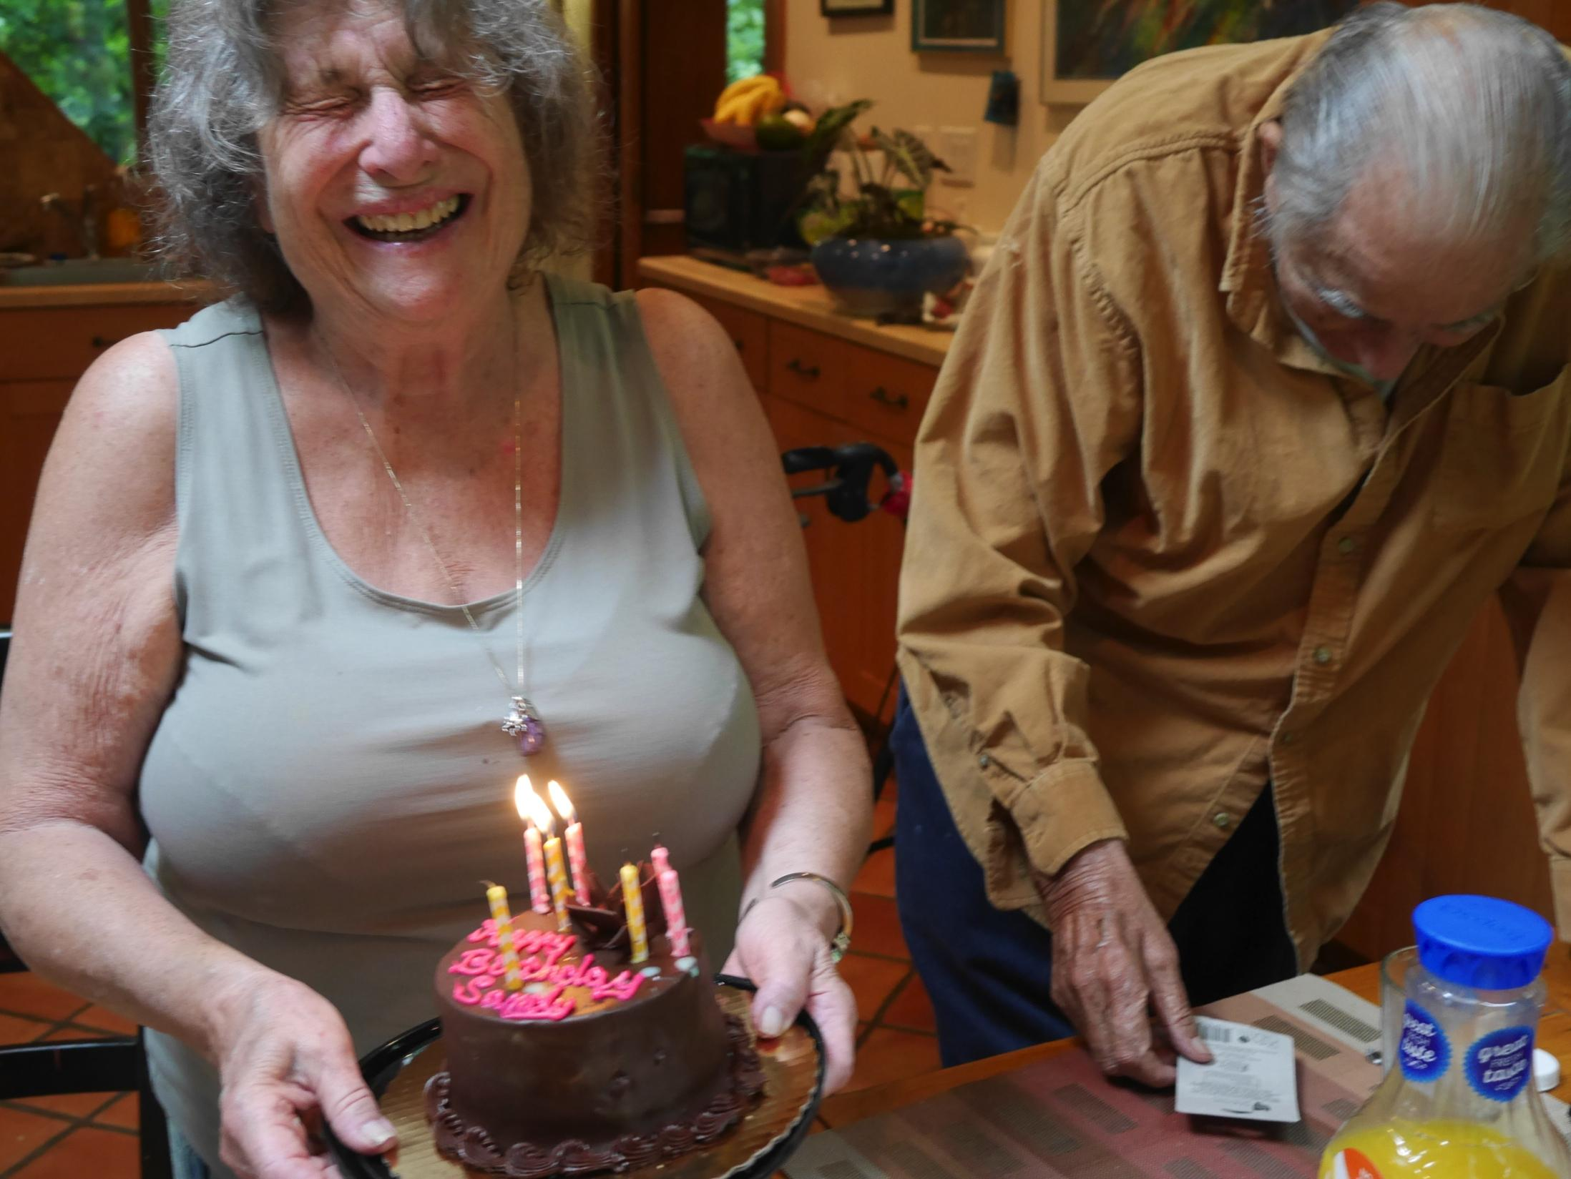
Older Workers
Sandy and Art Robbins have been married for 60 years. Art works as a psychotherapist, despite needing supplemental oxygen and using a walker. Sandy is the director of a children’s theater. This photo is from Sandy’s 82nd birthday.

Slide 17
@HunterBrookdale
Ruth Finkelstein, ScD
rf1132@hunter.cuny.edu
Professor of Public Policy
Executive Director
Brookdale Center for Healthy Aging, Hunter College
www.brookdale.org

